Slide 1
Week 5 – Friday: Life Skill #5: Paper Prototyping
R. Jordan Crouser
Assistant Professor of Computer Science
Smith College
SCS Noonan Scholars – Summer 2018

Slide 2
Outline
Prototyping
What it is
Why do it
Ways to do it
Life skill: paper prototyping
Break
Final project workshop

Slide 3
Final project proposals
13 / 25 people submitted (6 teams)
Awesome ideas so far!
Arcade
Mario port
Nuclear Reactor Simulator
Fractal Gallery
Rocket Builder
Musical Hangman
“mega-program” ☺

Slide 4

Discussion
Now that we have some ideas for final projects,
where do you start?

Slide 5
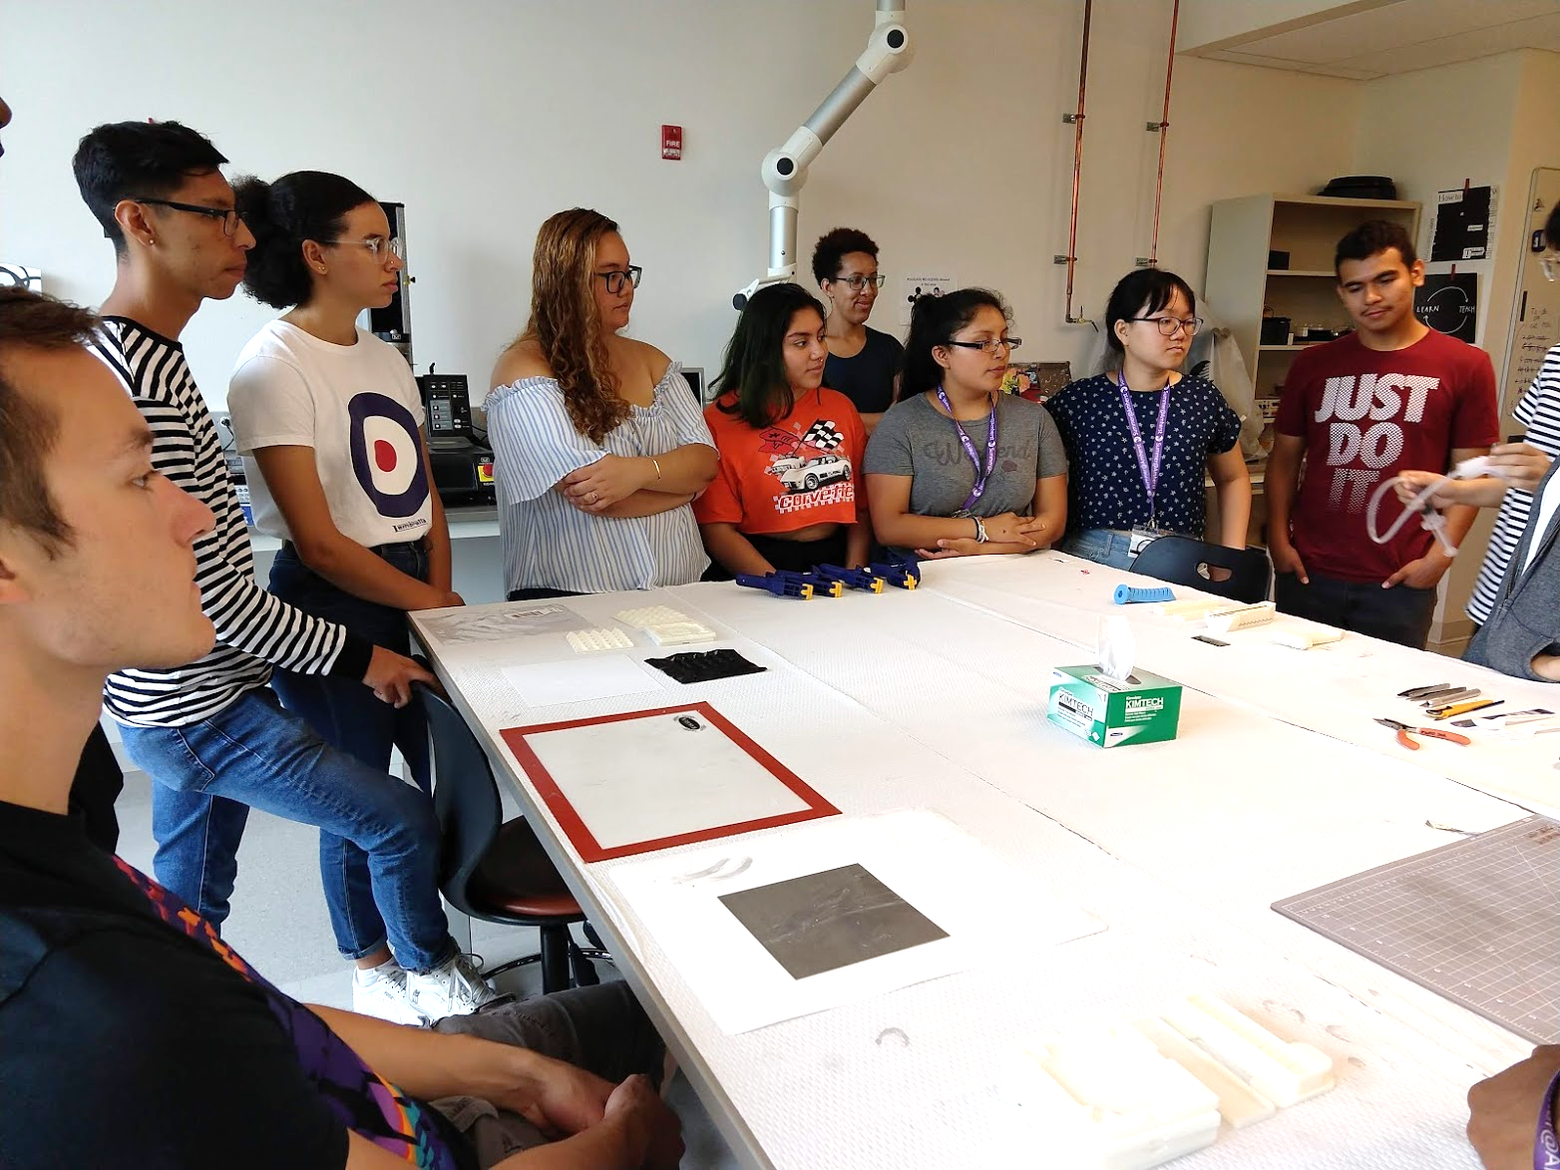
Last year: MicroSmithy visti

Slide 6
Discussion
What would a prototype for your final project
look like?

Slide 7
“Paper prototyping”
Big idea:
Not sure yet whether or not an idea will work?
Making a paper version of an interface is a lot faster and easier than coding a working prototype – start there!

Slide 8
“Paper prototyping” goals
Generate lots of ideas
Engage other people in the design process
Identify potential problems before you waste time coding
Get feedback quickly, from lots of different people
Some tips:
Focus on the big picture, don’t worry about the details
Think about what you want it to do, rather than what you know how to implement (we’ll worry about that later)

Slide 9
Our first paper prototype

Slide 10
Your turn!

Slide 11
Discussion
How did it go?
What did you notice?

Slide 12
Project Workshop

